Slide 1
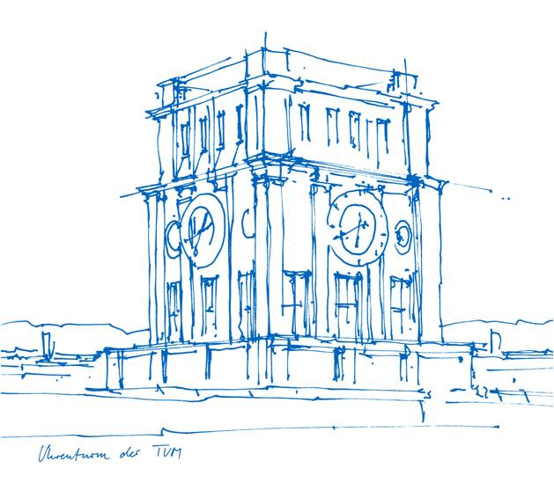
Long-Horizon Task Planning for Autonomous
Agents with Hybrid Architecture: a Systematic
Mapping Study
Marc Peñalver Guilera
Technische Universität München
TUM School of Computation, Information and Technology
Chair of Robotics, Artificial Intelligence and Real-time Systems
Location, Date (Munich: December 12, 2025)
Notes:
Marc Peñalver | I’m going to present my seminar topic, the reasearch methodology i will follow what i have currently achived & my next steps

Slide 2
1.1 Motivation
The Legacy of Traditional RPA: Robotic Process Automation (RPA) has historically dominated task automation by delivering cost reduction, efficiency, and error mitigation. However, these systems rely on predefined rules, making them rigid, fragile, and unable to adapt to unforeseen changes (Průcha, P. et al. 2025).
The Shift to Cognitive Automation: Recent advances in Large Language Models (LLMs) have introduced a new class of adaptable "language agents."
LLM Capabilities: Unlike traditional RPA, LLMs are entrusted with reasoning, planning, and decision-making. Their generalized knowledge empowers them to tackle complex tasks with inherent flexibility and minimal tuning (Ganguly, P. & Mukherjee, I. 2025).
Notes:
The title of my work is … why?

Slide 3
1.2 Problem Statement
The Flexibility–Compliance Dilemma: Traditional RPA guarantees high compliance but lacks flexibility. Conversely, LLM-based agents are highly flexible but suffer from significant deficits in reliability, particularly over extended action sequences (Průcha, P. et al. 2025).
Demonstrated Failures: State-of-the-art models struggle to maintain coherent long-term strategies, evidenced by success rates as low as 4.4% on benchmarks like TravelPlanner (Chen, Y., et al. 2024).
Core LLM Limitations:
Struggle to reason over long contexts.
Weak self-correction capabilities.
Prone to hallucinations.
Notes:
The title of my work is … why?

Slide 4
1.3 Research Questions
The Research Frontier: Overcoming this dilemma requires novel cognitive architectures that separate high-level planning from low-level execution, utilize environmental feedback loops for self-correction, and enable dynamic replanning (Chen, Y., et al. 2024, Průcha, P. et al. 2025).
The goal of this seminar is to systematically map and categorize these architectural strategies for hybrid long-horizon planning currently employed in the literature. To achieve this the following research questions are addressed:
RQ1: What is the trend in publication over time and the distribution of research types and venues in the field of hybrid long–horizon planning?
RQ2: What specific challenges and limitations in autonomous agents do current hybrid architectures aim to address, and what paradigms are they intended to automate?
RQ3: What architectural mechanisms are employed by MAS and agentic AI systems to address these challenges, and what are the identified gaps for long–horizon task automation?
Notes:
The title of my work is … why?

Slide 5
2.1 Research Methodology
The study follows the systematic mapping guidelines established by Petersen et al. (2015) to ensure descriptive and theoretical validity.
Search Strategy: Utilised the PICO framework (Population and Intervention) to define the scope and iteratively derive keyword combinations and synonyms to refine the search strings. Defined and applied inclusion and exclusion criteria for each of the evaluated papers.
Data Sources: Conducted searches across the following venues: IEEE Xplore, Scopus, and the ACM Digital Library.
Data Extraction: Developed a structured extraction form covering metadata, research questions, and administrative fields to systematically process each paper.
Quality Assessment: Evaluated methodological rigour across six dimensions (e.g., Clear Goal, Empirical Evidence, Threats discussed) to score and classify studies from Limited to High Rigour.
Notes:
The title of my work is … why?

Slide 6
2.2 Papers included from the Digital Libraries
Selection Criteria: Established strict inclusion/exclusion rules, filtering for peer-reviewed, English-language studies published between 2020 and 2025.
Preprocessing: Exported metadata for automated processing and utilised a Python script to normalise fields and remove duplicate records based on DOIs.
AI-Assisted Screening: Leveraged a Language Model for initial title and abstract screening to flag irrelevant or non-English documents, followed by manual researcher review.
Snowballing: Conducted backward-and-forward snowball sampling on the highest-quality papers to identify additional relevant literature.
Notes:
The title of my work is … why?

Slide 7
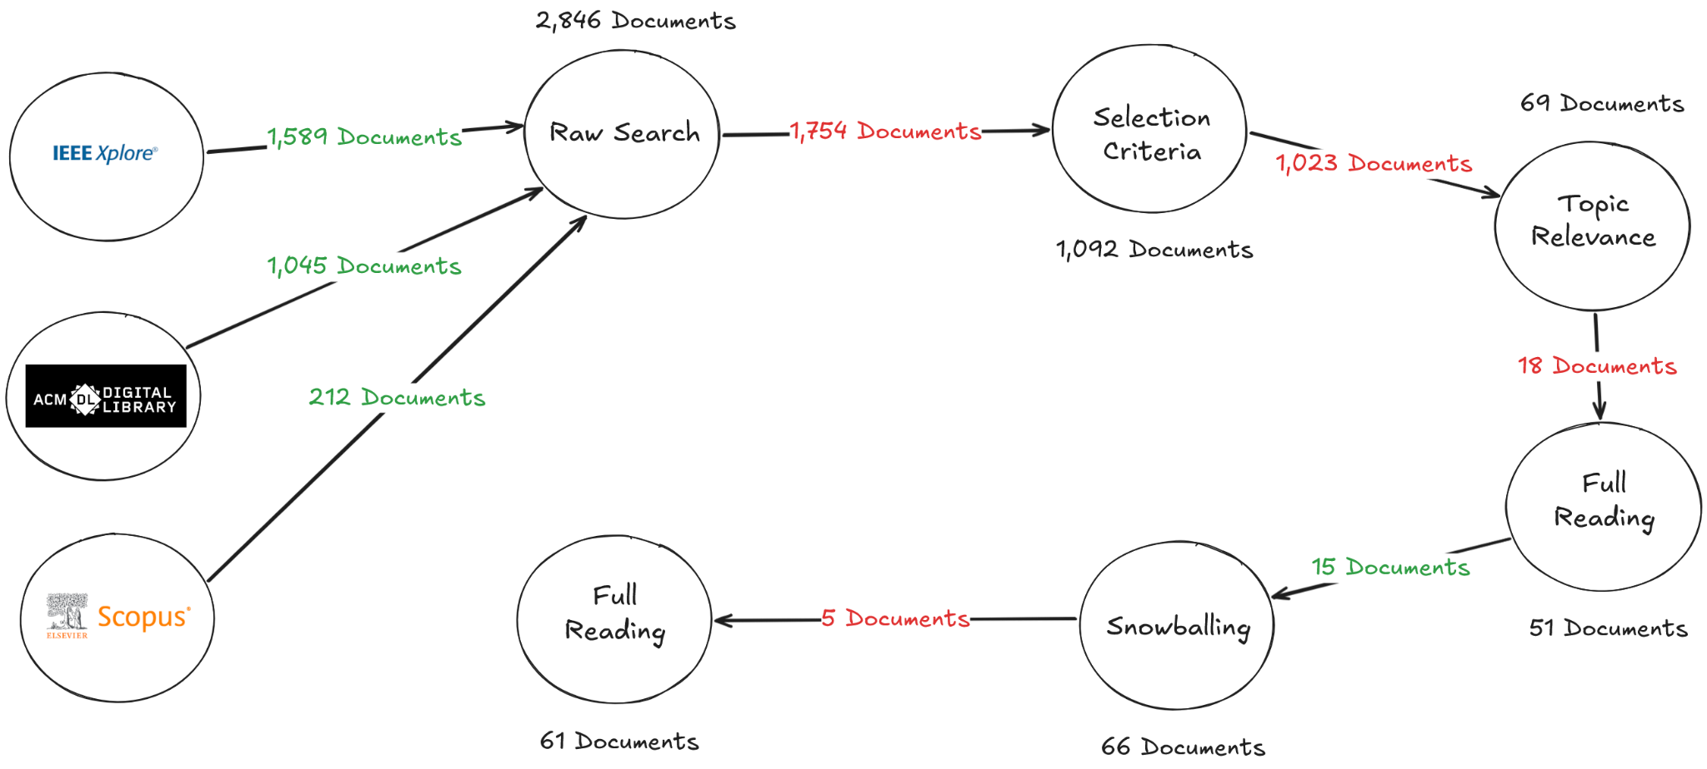
2.3 Papers included from the Digital Libraries
Notes:
The title of my work is … why?

Slide 8
2.4 Classification Schemas
Derivation Process: Schemas were developed iteratively through an open coding process conducted during the full-text reading phase.
RQ1 Topic-Independent Classification: Papers were categorised by standard dimensions, specifically Research Type (e.g., evaluation, solution proposal) and Venue Type.
RQ2 Schemas: Derived categories mapping the specific Challenges Addressed (e.g., Long-Horizon Failure, Brittleness) and the target Automation Paradigms (e.g., Embodied AI, Knowledge-Intensive BPM).
RQ3 Schemas: Classified the architectural mechanisms into distinct modules: Neural Components, Symbolic Mechanisms, Memory Systems, Self-Correction Approaches, and Compliance Reasoning Paradigms.
Notes:
The title of my work is … why?

Slide 9
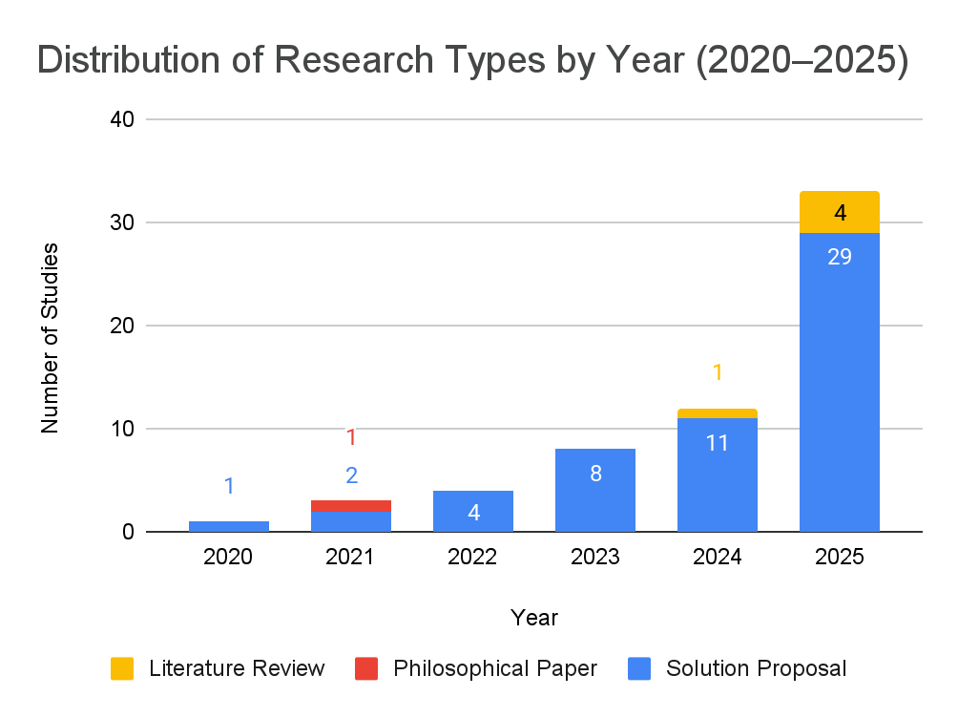
3.1.1 RQ1 - Trend Analysis of Research Facets.
Exponential Growth: Rapid surge in publications, growing from a single study in 2020 to 33 in 2025.
Solution Dominance: ~90% of literature consists of "Solution Proposals," indicating a heavy focus on architectural design.
Empirical Gap: A complete absence of "Evaluation" or "Validation" research suggests the field lacks large-scale, real-world industrial testing.
Emergence of Synthesis: Literature reviews only appeared in 2024/2025, signaling that the field has finally reached a critical density requiring consolidation.
Pragmatic Shift: Theoretical research has shifted from abstract "Philosophical Papers" to pragmatic, implementation-first engineering within solution proposals.
Notes:
The title of my work is … why?

Slide 10
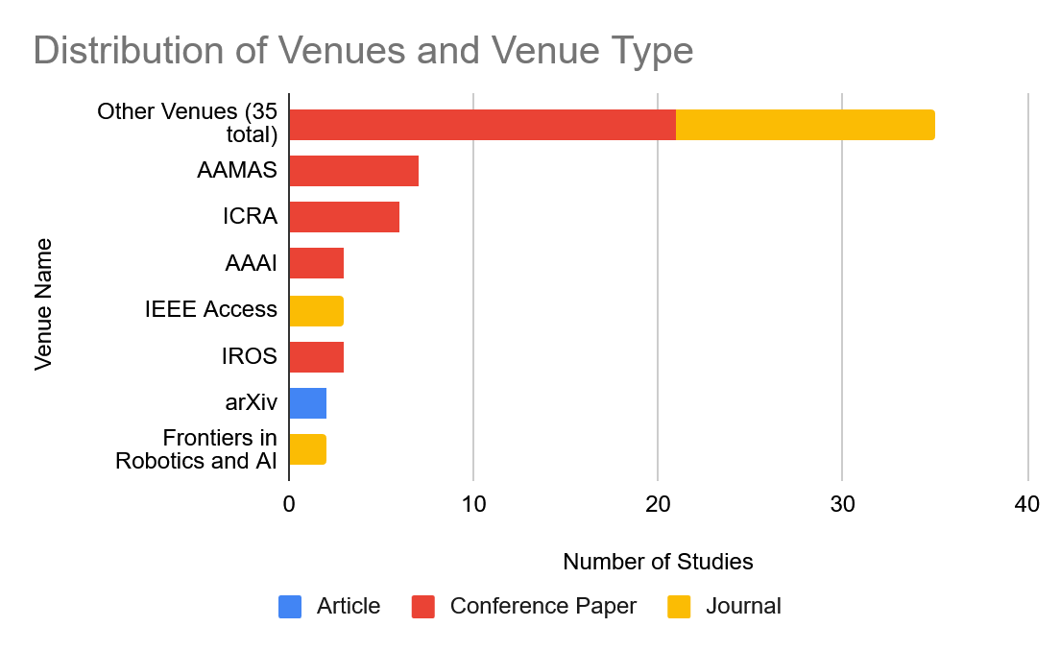
3.1.2 RQ1 - Publication Venues and Categories
Leading Hubs: Research is concentrated in top-tier AI and Robotics communities, with AAMAS and ICRA accounting for ~20% of all papers.
Conference Dominance (2:1 Ratio): Preference for conferences over journals reflects a fast-paced environment prioritizing rapid dissemination and engineering pragmatism.
Implementation-First Focus: The shift toward conferences reinforces that "theory" is being integrated directly into functional prototypes rather than standalone philosophical papers.
High Fragmentation: A "long tail" of 35+ unique venues (IoT, HCI, Software Engineering) shows universal appeal across computing, though the field lacks a single, unified publication home.
Notes:
The title of my work is … why?

Slide 11
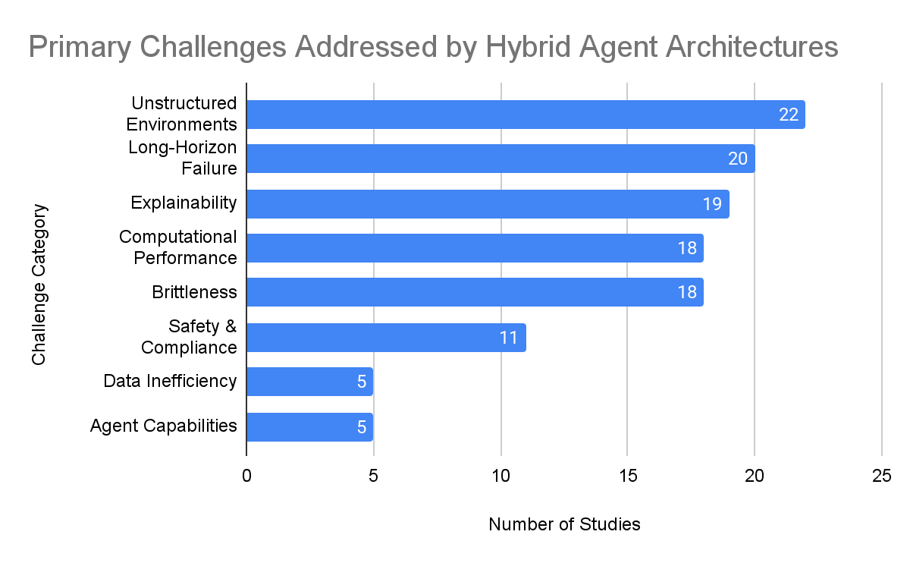
3.2.1 RQ2 - Challenges Addressed by Hybrid Architectures
Primary Challenges: Explainability, Long-Horizon Failure, and Unstructured Environments drive the current research.
The Hybrid Solution:
Symbolic: Provides formal logic to solve planning failures (Xu, R. et al. 2022).
Neural: Handles high-dimensional perception in unstructured environments (Ahmetoglu, A. et al. 2022).
Notes:
The title of my work is … why?

Slide 12
3.2.1 RQ2 - Challenges Addressed by Hybrid Architectures
Performance in Robotics: ~41% of robotics papers focus on Computational performance. This can be explained by a growing trend toward dual-planning architecture (Chiari, M. et al. 2024).
Priority Shift: The field is prioritizing Reliability and Transparency (fixing fundamental flaws) over adding new features or improving data efficiency.
Notes:
The title of my work is … why?

Slide 13
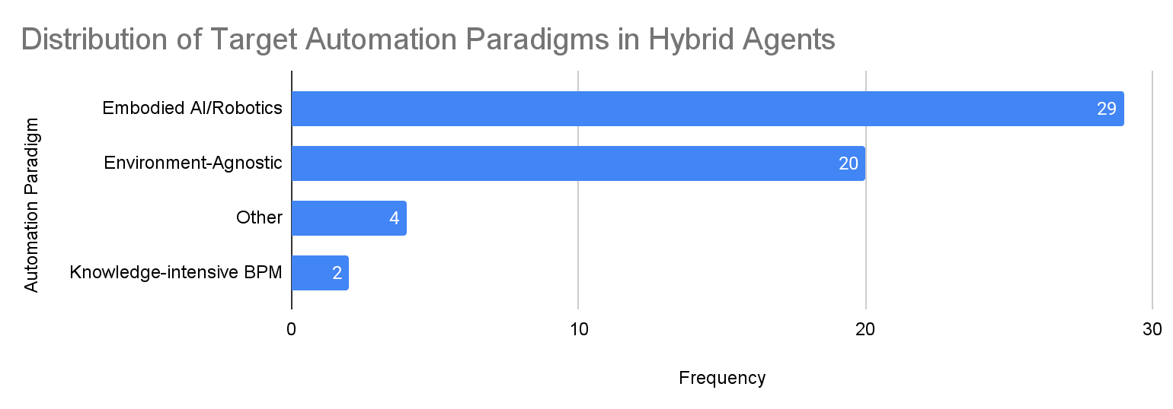
3.2.2 RQ2 - Automation Paradigms of Hybrid Architectures
Dominant Contexts: ~90% of research is concentrated in Embodied AI/Robotics and Environment-Agnostic frameworks.
Embodied AI & Robotics (52.7%): The primary testing ground for neuro-symbolic splits; utilizes neural layers for perception and symbolic layers for safe, deterministic execution.
Environment-Agnostic (36.4%): Focuses on modularity and generalizability, treating the neural-symbolic interface as a standalone architectural challenge.
Industry Disconnect (BPM/RPA): Only 3.6% of papers focus on business process management. Despite industry demand for "Cognitive RPA," academic research in this area is currently underserved.
Niche Applications (7.3%): Limited focus on specialized domains like narrative planning and dialogue management, which remain peripheral to the core research effort.
Notes:
The title of my work is … why?

Slide 14
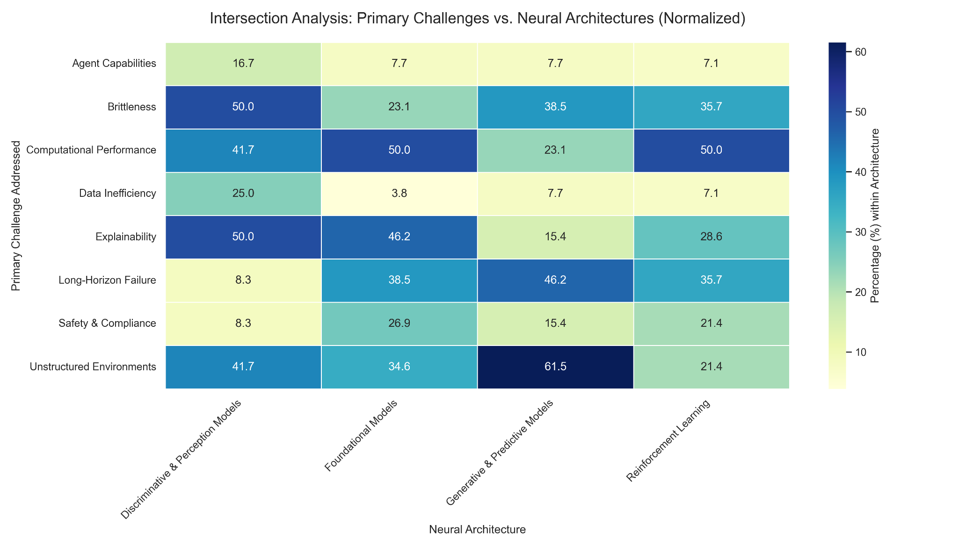
3.3.1 RQ3 - Neural Architectural Classes
Foundational Models (FM) as "Semantic Engines":
Act as generalists translating unstructured data into high-level abstractions rather than raw perception (Kwon, M. et al. 2025).
Key drivers for Explainability (46.2%) and mitigating Long-Horizon Failure (38.5%).
Generative & Predictive Models:
Managing environmental ambiguity and state-estimation (Gupta, J. et al. 2024).
Highly specialized for Unstructured Environments (61.5%).
Notes:
The title of my work is … why?

Slide 15
3.3.1 RQ3 - Neural Architectural Classes
Discriminative & Perception Models:
Focus on reducing Brittleness (50.0%) and handling Unstructured Environments (41.7%).
Utilize non-linear sensor fusion to approximate the state of the world.
Division of Labor: A clear architectural pattern where neural models handle high-level translation and sensing, while symbolic components manage the logic (Nam, C. et al. 2020).
Notes:
The title of my work is … why?

Slide 16
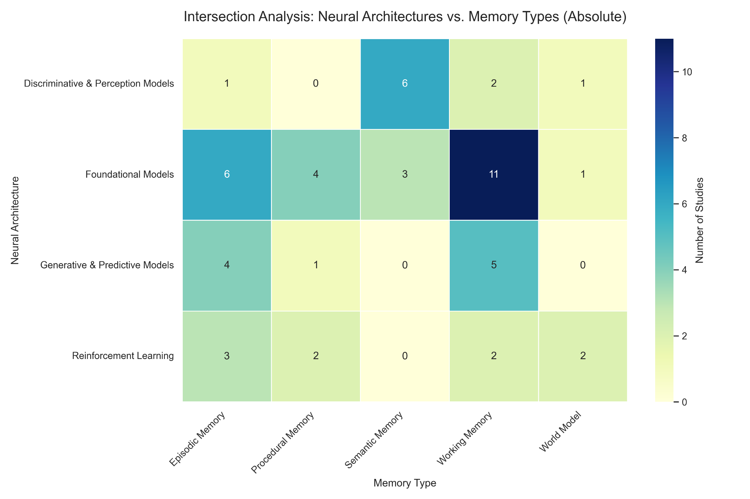
3.3.1 RQ3 - Neural Architectural Classes
Reliance on Volatile Memory: ~40% of Foundation Models (FM) rely on Working Memory (context windows) rather than durable anchors.
Durability Risk: Dependence on transient context windows creates a "Fragility Gap," threatening the reliability of extended, long-horizon tasks (Kane, B. et al. 2022).
Notes:
The title of my work is … why?

Slide 17
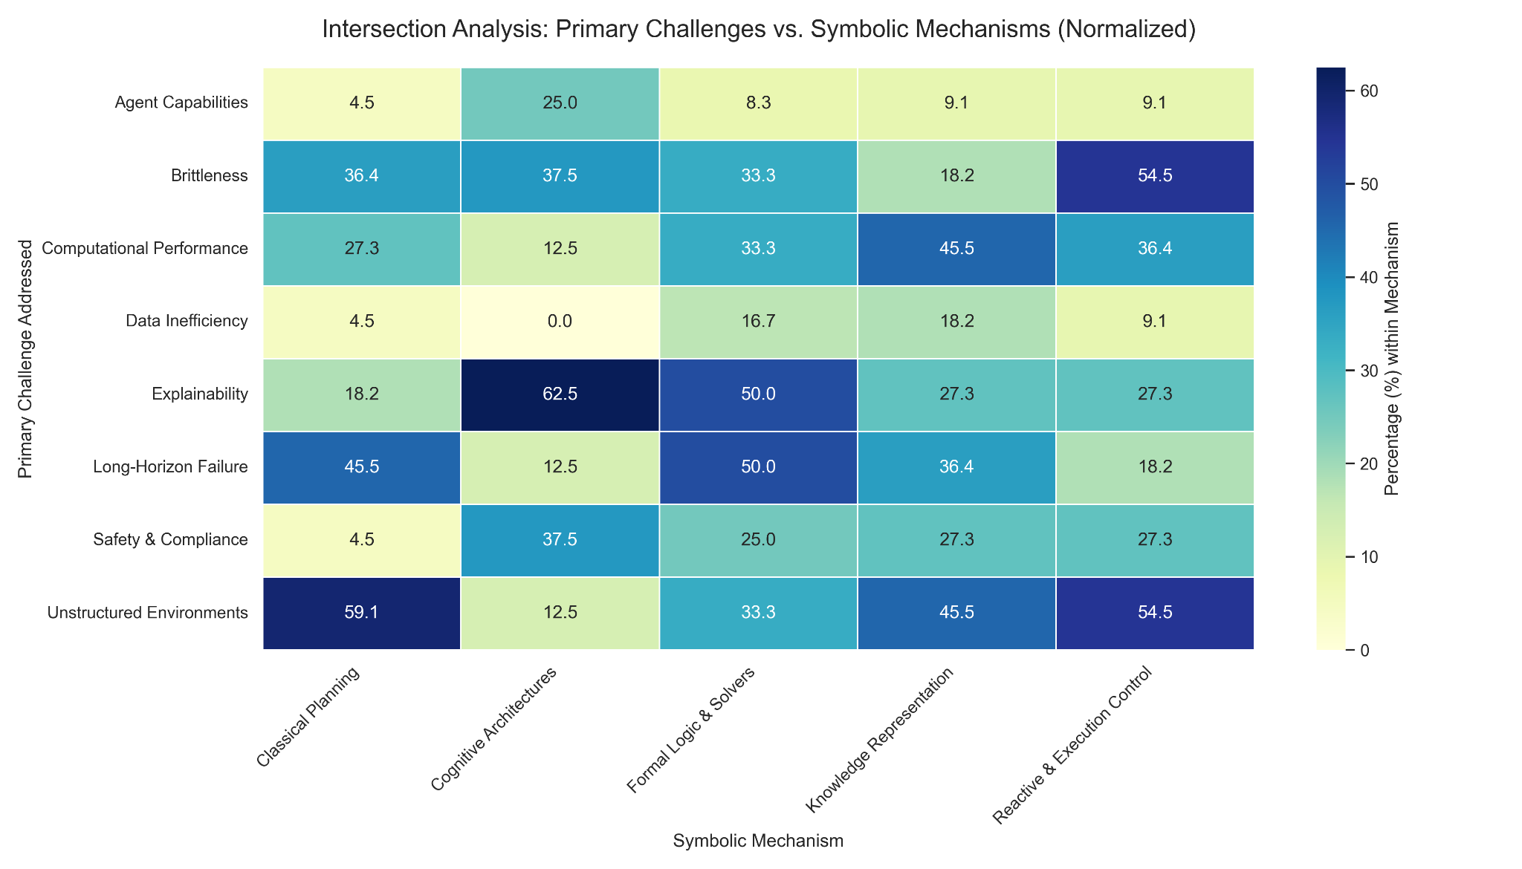
3.3.2 RQ3 - Symbolic Architectural Mechanisms
Classical Planning:
Highest affinity for Unstructured Environments (59%) and Long-Horizon Failure (45%).
Primary tool for maintaining logical consistency over extended temporal scales (Dagan, G. et al. 2023).
Cognitive Architectures:
Specialized for Explainability (62.5%).
Utilized to provide intentionality and transparency to agent behavior (Chaput, R et al. 2021).
Notes:
The title of my work is … why?

Slide 18
3.3.2 RQ3 - Symbolic Architectural Mechanisms
Knowledge Representation (KR):
Affinity for Unstructured Environments (45.5%) and Long-Horizon Failure (36.4 %).
Provides Foundational Models with a stable ontology. Prevents reliance on raw latent representations by offering a queryable, structured environment map (Ciatto, G. et al. 2021).
Notes:
The title of my work is … why?

Slide 19
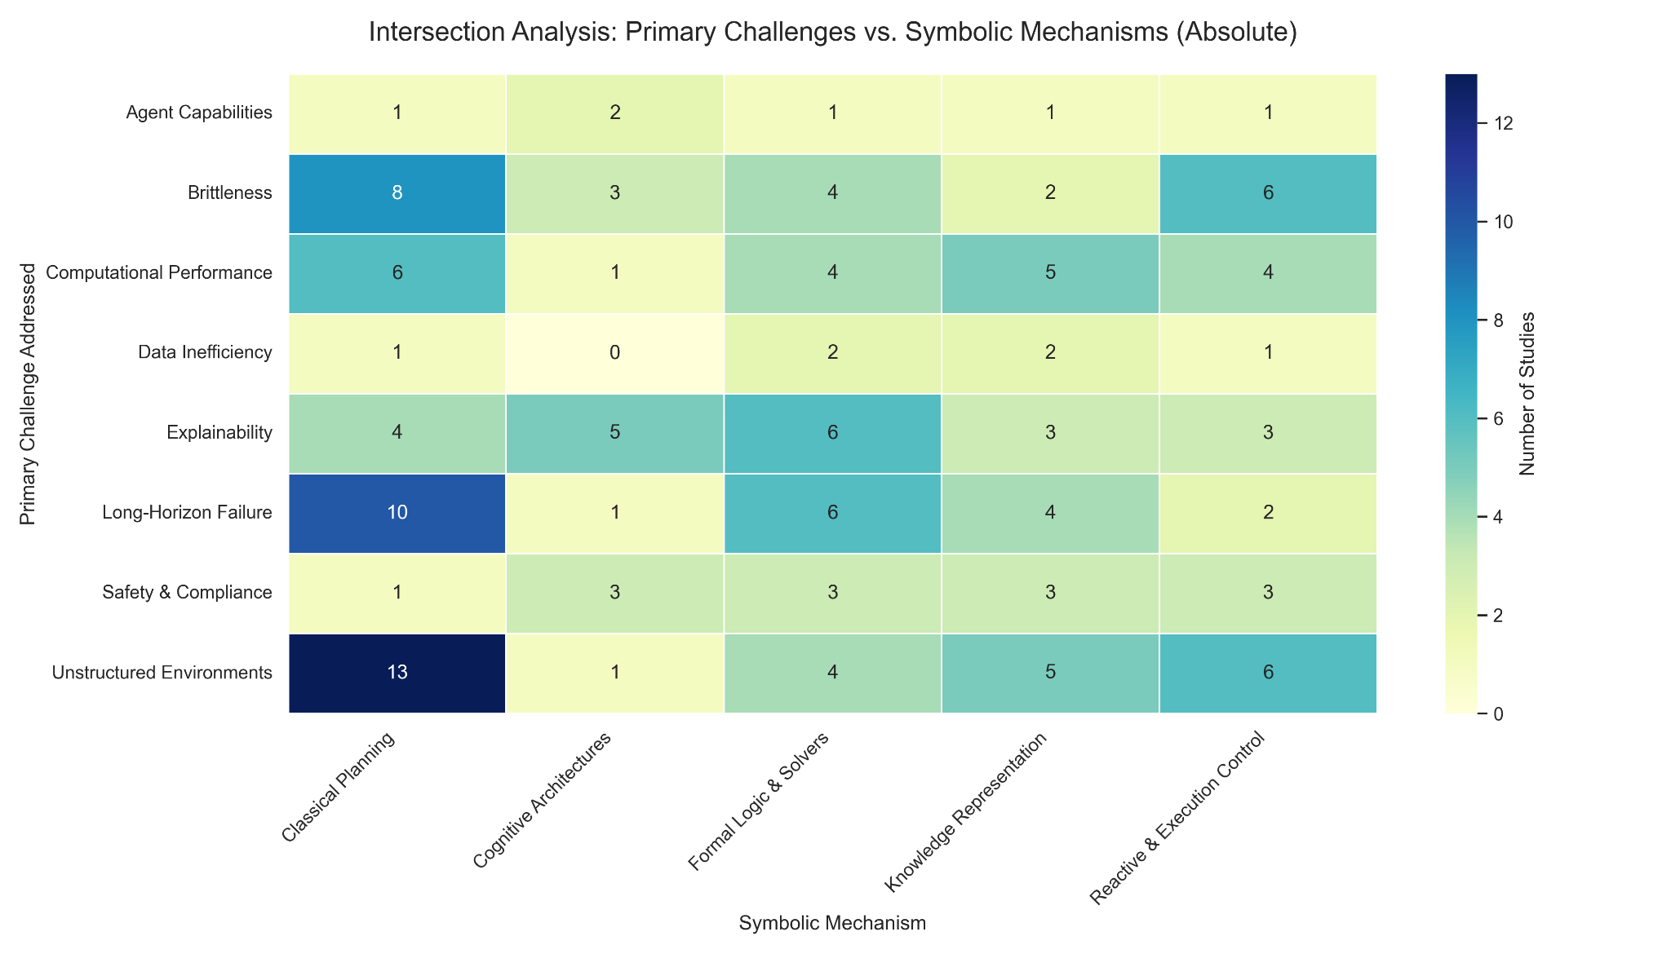
RQ3 - Symbolic Architectural Mechanisms
Secondary Priority: Despite being a primary driver for hybrid models, safety is often treated as a "byproduct" of execution rather than a core architectural focus.
Logic vs. Safety: Symbolic layers are currently prioritized for logical task completion, leaving a significant gap in dedicated safety-first design.

Slide 20
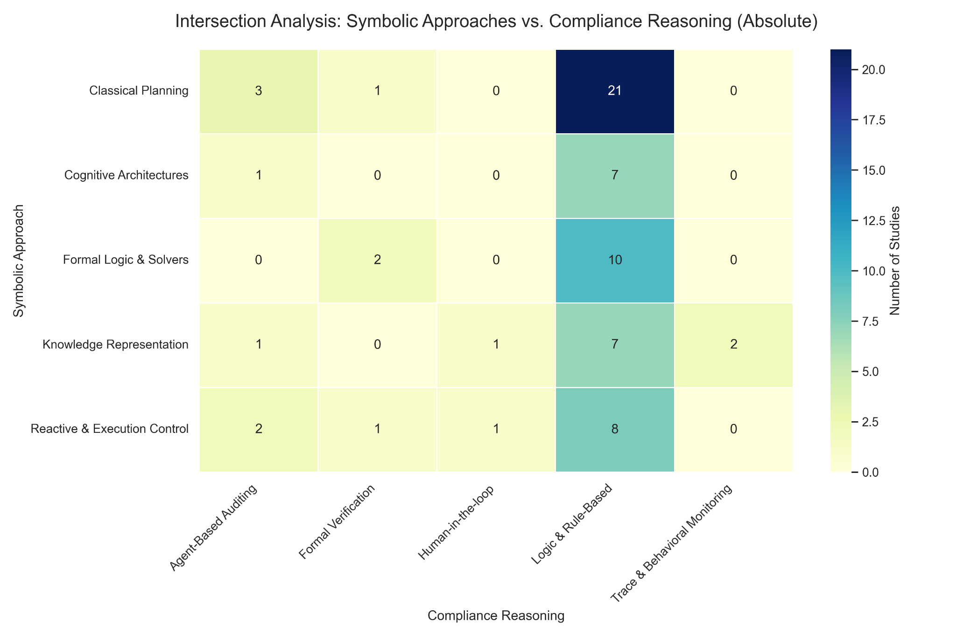
3.3.2 RQ3 - Symbolic Architectural Mechanisms
Generalist Trap: Industry requires "bulletproof" compliance, but research currently relies on general-purpose rule-based logic rather than specialized safety-critical reasoning.
The Compliance Gap: Safety is treated as a broad logical exercise rather than a dedicated architectural constraint, creating a misalignment between academic "logic" and industrial "verification."
Notes:
The title of my work is … why?

Slide 21
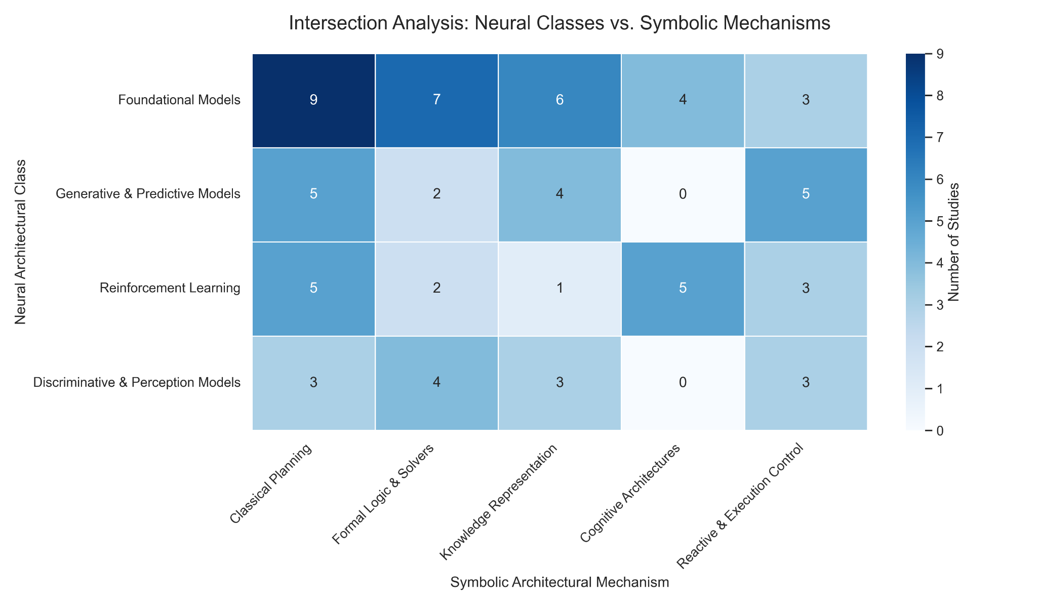
3.3.3 RQ3 - Neuro-Symbolic Architectural Interfaces
FM + Classical Planning (Translation): The most common pattern; utilizes the Neural model as a semantic front-end to convert intent into rigid symbolic action languages, preventing hallucinations.
GEN + Formal Logic (Verification): A "generative-verification" loop where neural models propose solutions that are then validated against mathematical or temporal guardrails.
FM + Knowledge Representation (Grounding): Uses Symbolic Knowledge Injection (SKI) to anchor neural models in a stable ontology, ensuring logical consistency.
RL + Cognitive Architectures (Intentionality): Employs symbolic frameworks to manage the "mental state" of agents during reinforcement learning, providing scrutability to policy optimization.
Notes:
The title of my work is … why?

Slide 22
3.3.3 RQ3 - Neuro-Symbolic Architectural Interfaces
Generative Models + Planning/Execution (Orchestration): Act as mid-level orchestrators, breaking down high-level goals into subgoals for search algorithms or real-time control loops.
Identified Structural Gap: High-level mental modeling (Cognitive Architectures) is rarely connected to raw perception; it remains mediated by planning or logic layers.
Core Engineering Focus: Current research is primarily centered on Translation, Grounding, and Verification pipelines.
Notes:
The title of my work is … why?

Slide 23
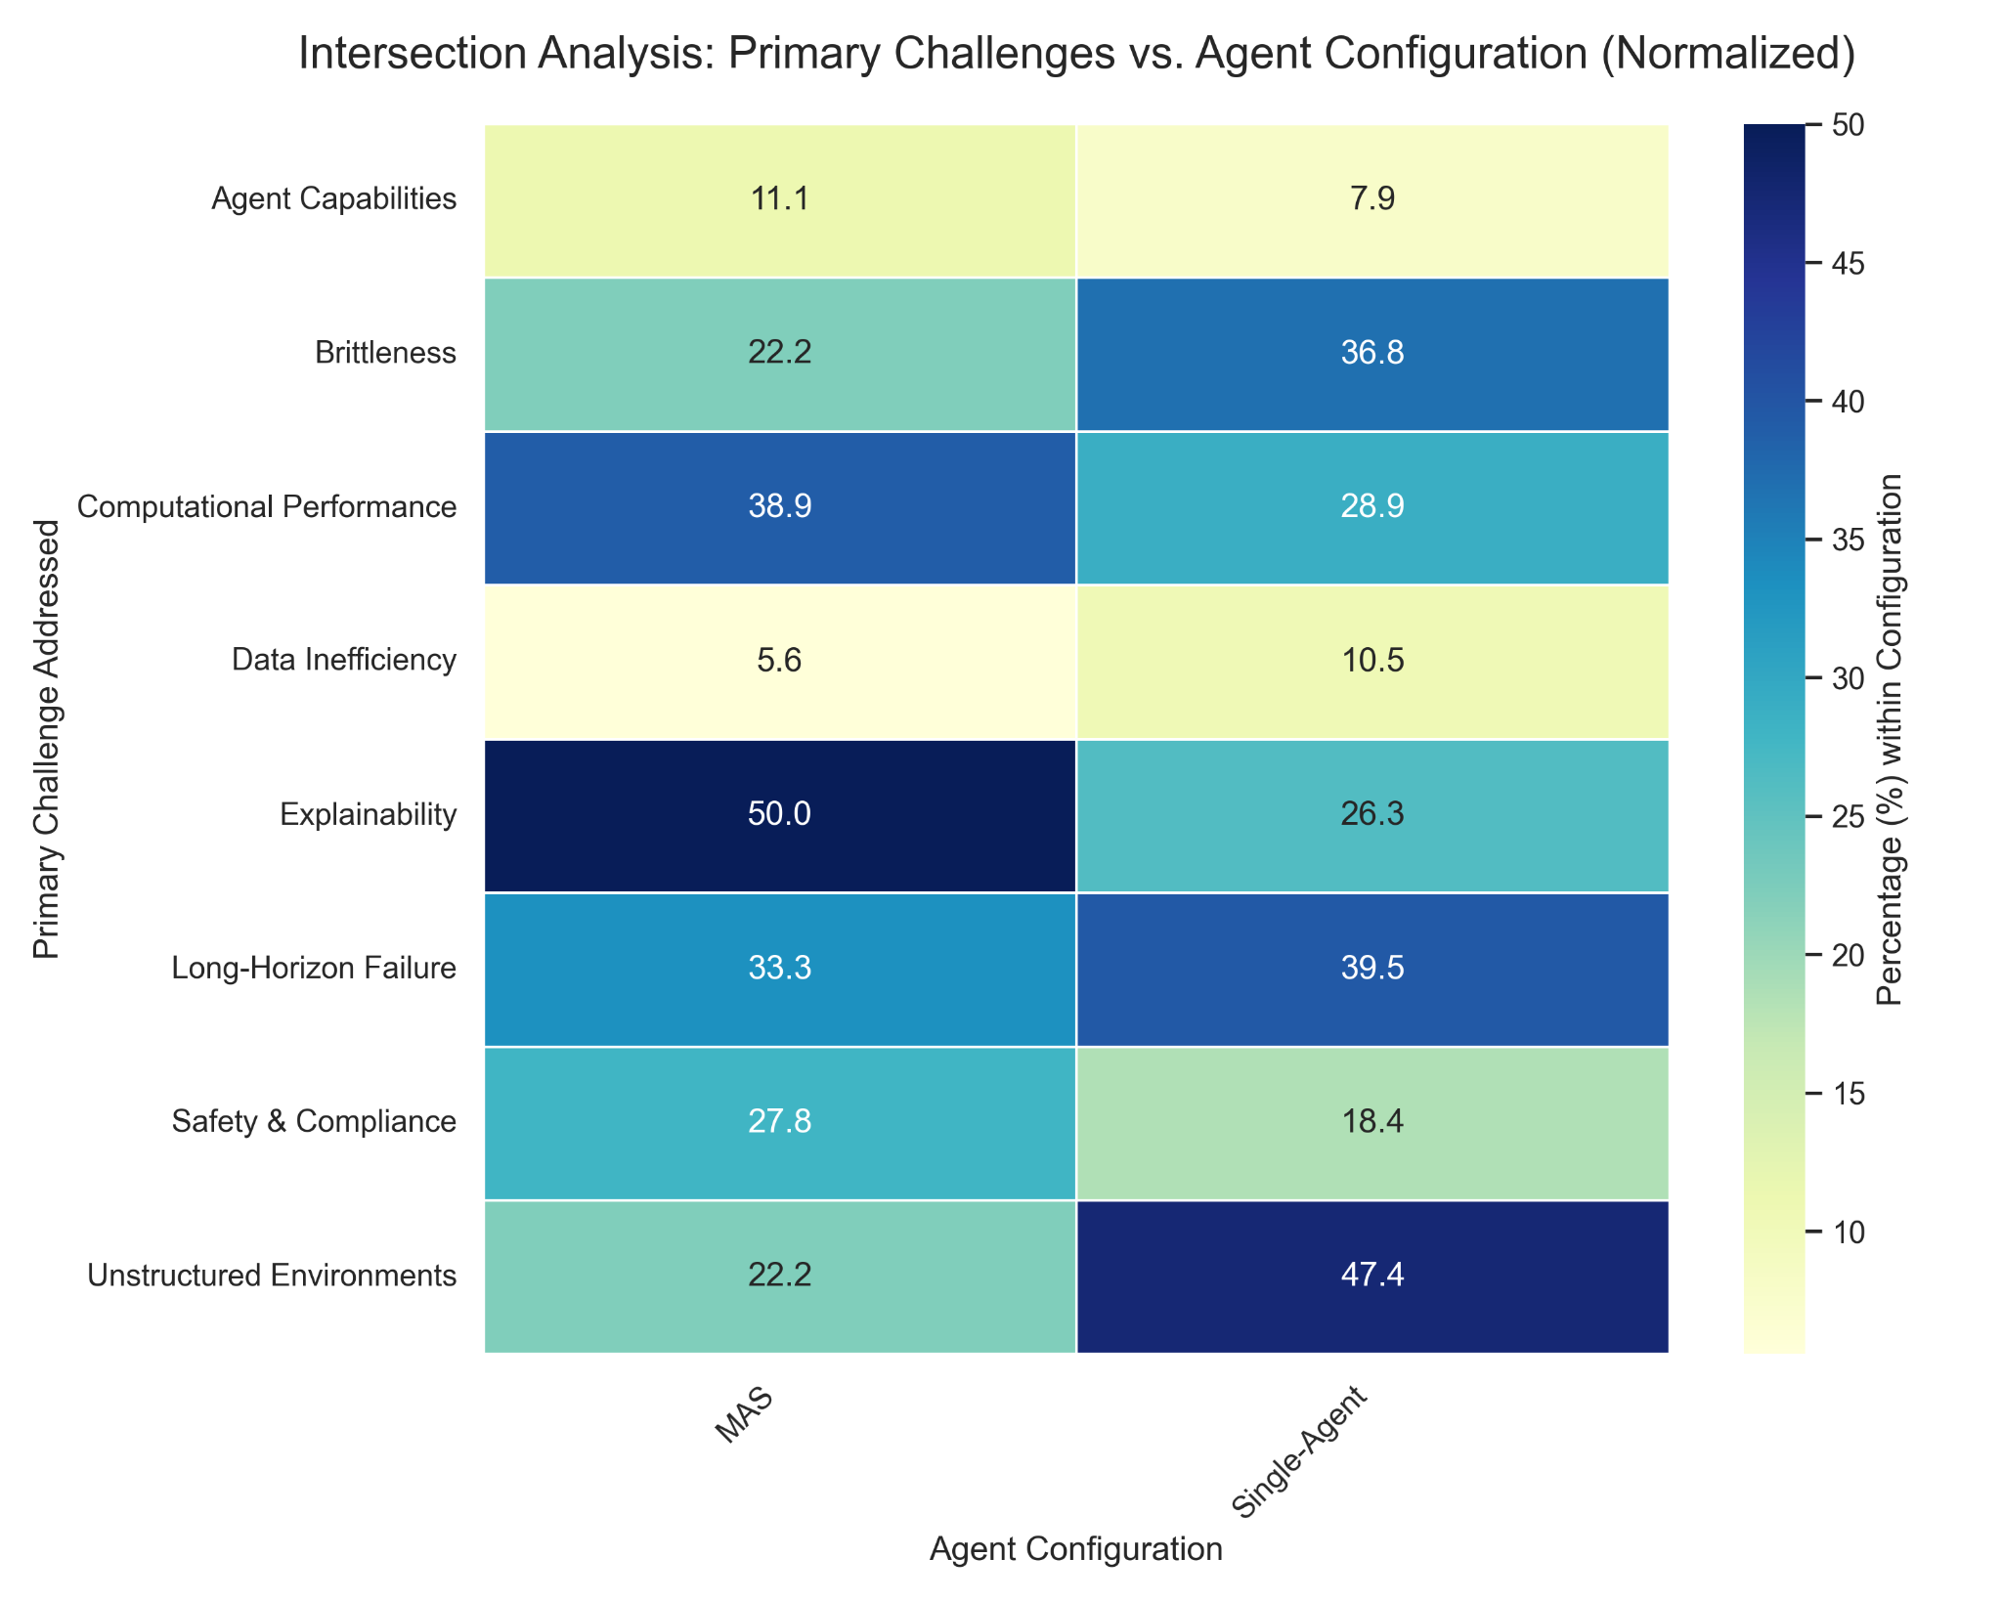
3.3.4 RQ3 - Agent Configurations
Single-Agent Dominance (68%): Centered on centralized architectures due to lower implementation complexity.
MAS & Explainability (50%): Multi-Agent Systems are prioritized to solve the "black-box" problem through role-based decomposition (Sadowski, A. & Chudziak, J.A. 2025).
The "Actor-Auditor" Pattern:
Compliance is treated as an external auditing task rather than an internal constraint.
Decentralized monitoring and communication traces provide the transparency that symbolic logic alone cannot yet guarantee.
Notes:
The title of my work is … why?

Slide 24
3.3.4 RQ3 - Agent Configurations
Addressing the Safety Gap: MAS fills the "Logical-Safety Gap" by providing explicit oversight and behavioral traces.
Internal Brittleness: Single-agent systems report higher brittleness (36.8%), suggesting that the fragility of neuro-symbolic integration is currently seen as an internal failure of individual agent logic.
Notes:
The title of my work is … why?

Slide 25
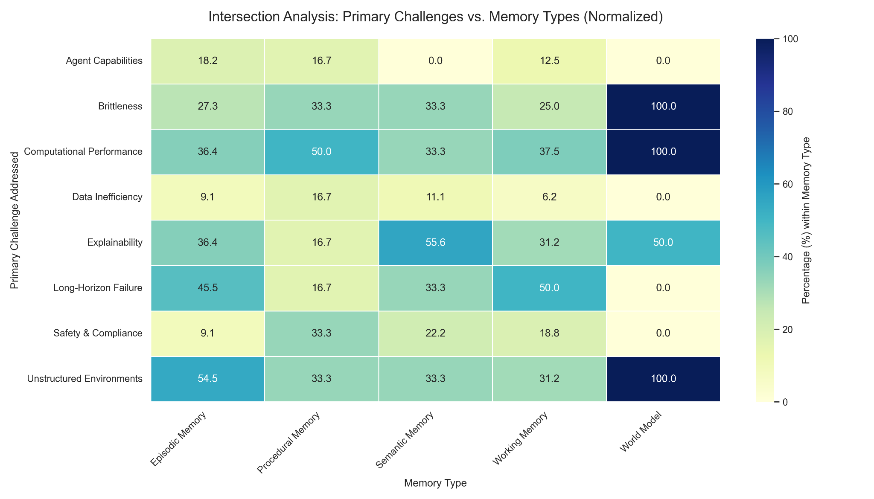
3.3.5 RQ3 - Memory Types
Working Memory Baseline: Primarily used for FM context management; highlights a gap in architectures that decouple long-term planning from volatile prompt windows.
Semantic Memory for Explainability (55.6%): Acts as a factual anchor, grounding neural outputs in stable ontologies to provide transparency (Sadowski, A. & Chudziak, J.A. 2025).
Notes:
The title of my work is … why?

Slide 26
3.3.5 RQ3 - Memory Types
The World Model Gap:
World Models show 100% affinity for Unstructured Environments and Brittleness.
Crucially, they show 0% affinity for Long-Horizon Failure.
Spatial vs. Temporal Grounding: Internal simulation is currently used for immediate spatial/semantic reasoning, but is rarely used for proactive, long-term temporal simulation.
Notes:
The title of my work is … why?

Slide 27
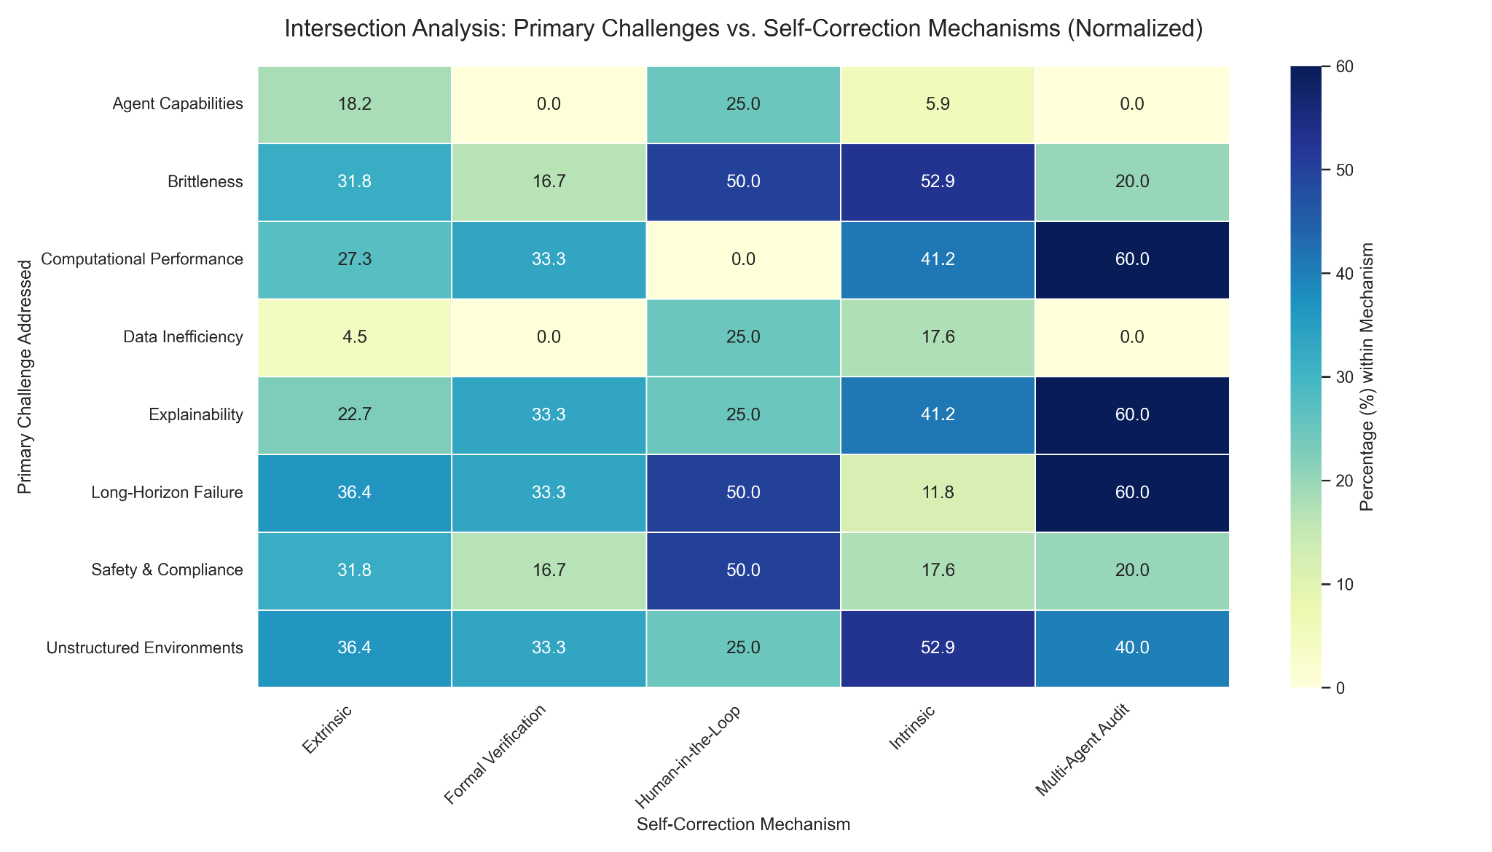
3.3.6 RQ3 - Self-Correction Mechanisms
Intrinsic Reflection (52.9%): Preferred for addressing Brittleness; uses "metacognitive" loops to resolve edge-case failures internally.
Multi-Agent Auditing (60%): The primary driver for Explainability; provides decentralized oversight and clear behavioral traces for complex execution.
Human-in-the-Loop: Remains the standard for Safety & Compliance, serving as the essential fallback when automated logic reaches its limits.
Notes:
The title of my work is … why?

Slide 28
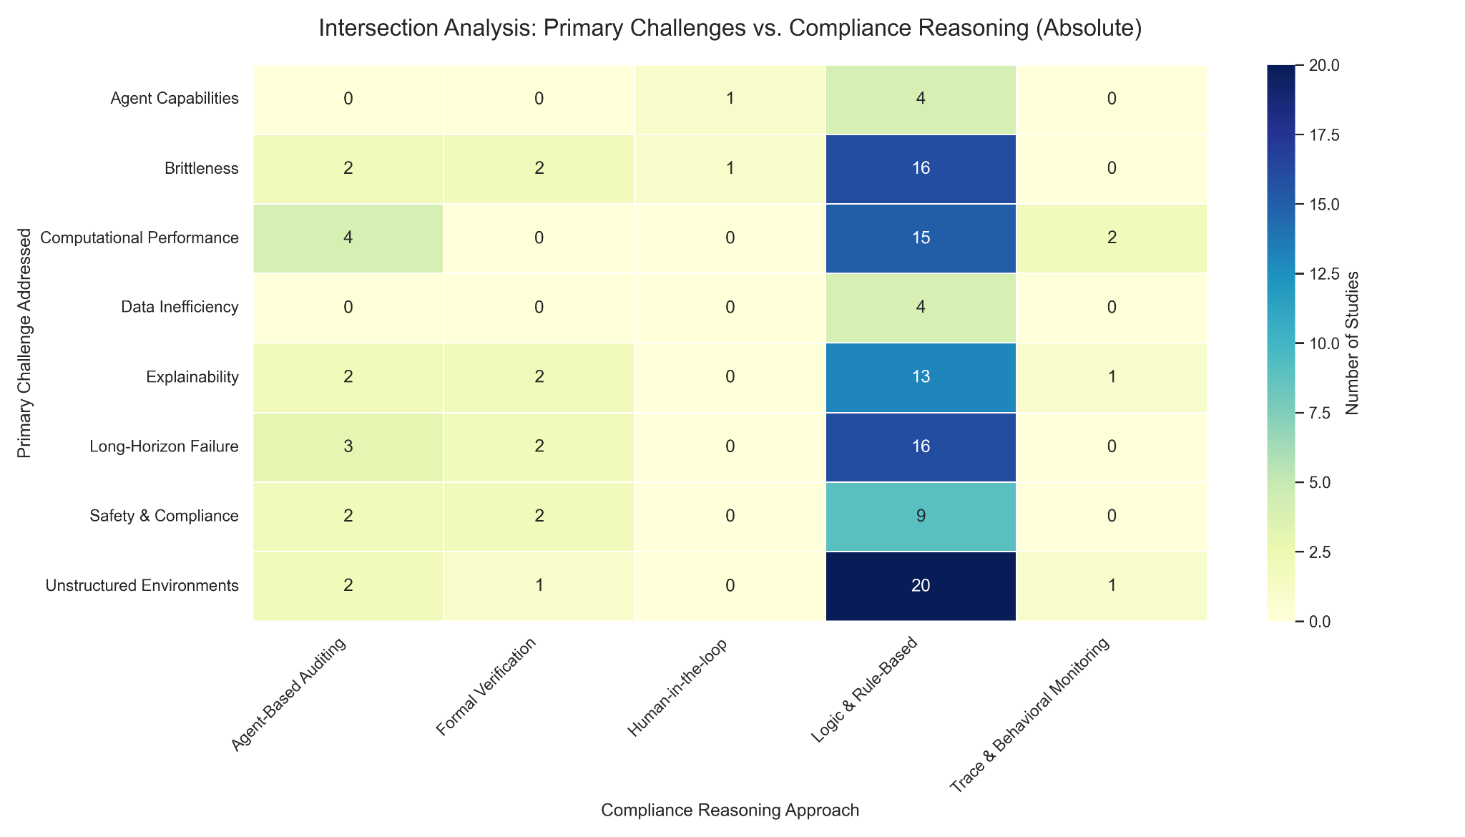
3.3.7 RQ3 - Compliance Reasoning
Despite its importance, data on compliance reasoning is sparse across all categories, indicating it is currently under-researched.
Compliance is primarily handled via general Logic & Rule-Based infrastructure rather than specialized, safety-critical reasoning.
The "flexibility-compliance" dilemma is recognized as a major challenge, but no repeatable, specialized patterns have emerged to solve it beyond traditional symbolic constraints.
Notes:
The title of my work is … why?

Slide 29
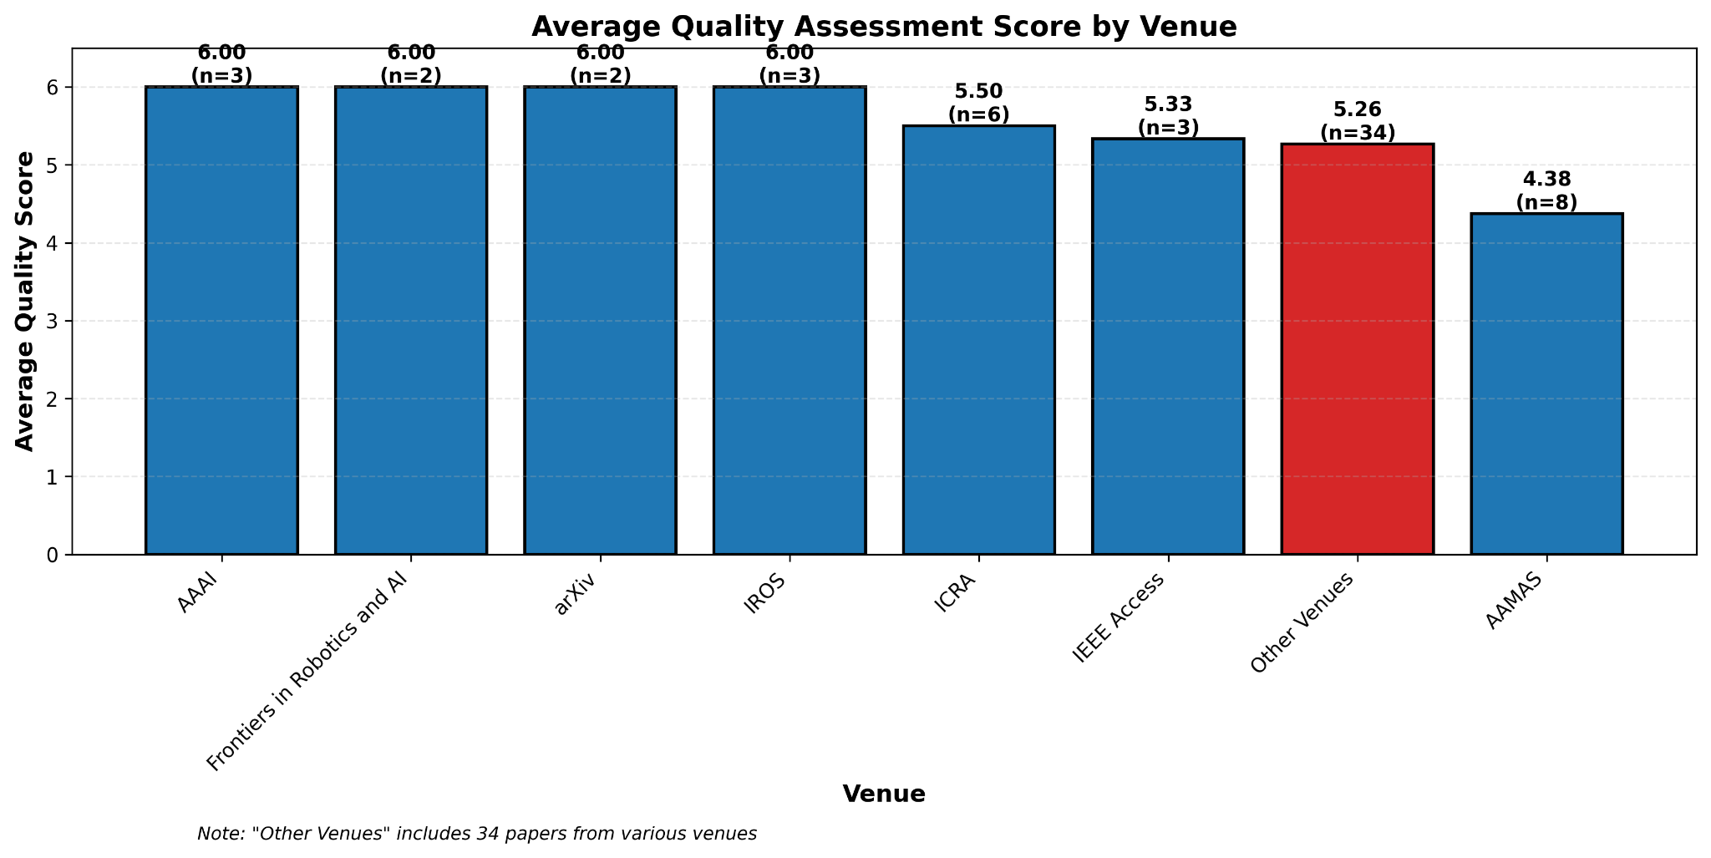
3.4 Quality Assessment
Overall Reliability: High standard of reporting with a mean rigor score of 5.30/6.00.
Quality Breakdown:
High Rigor (6/6): 67% (41 studies)
Limited Rigor (<5/6): ~20% (12 studies)
Venue Performance:
AAAI, IROS, and Frontiers maintain perfect 6.00 averages.
AAMAS shows the most significant quality fluctuation, with a lower average of 4.38.
Notes:
The title of my work is … why?

Slide 30
3.4 Quality Assessment
Reporting Trends by Research Type:
Quality scores are often a byproduct of the research type (e.g., philosophical papers score lower due to a lack of empirical testing). Critically, nearly all instances of missing results or empirical evidence occur within Solution Proposals: New architectures are being introduced faster than they can be rigorously documented or verified.
Analysis of Quality Criteria:
While 92% acknowledge system limitations, only 79% identify threats to validity, showing a lack of critical reflection on study design. A significant interpretive threat exists where results in 3D simulations are assumed to generalize to the real world without explicit proof.
Implications for the conclusions:
High average rigor (5.30) confirms that identified structural gaps (Safety/Fragility) are genuine architectural challenges, not the result of poor reporting.
The high score for methodological description (93%) ensures that these patterns are documented clearly enough for the community to transition from a focus on "execution" to a more rigorous paradigm of "autonomous verification."
Notes:
The title of my work is … why?

Slide 31
4 Conclusions
Current Field Maturity: The literature demonstrates high proficiency in Translation (converting neural semantic understanding into formal symbolic action languages) (Dagan, G et al. 2023, Ichida, A.Y. & Meneguzzi, F. 2023) and Explainability (achieved via Multi-Agent Systems and Semantic grounding) (Cai, X. et al. 2025, Sampath, A.N. et al. 2025).
The Contextual Fragility Gap: There is an over-reliance on volatile prompts and Working Memory; architectures are currently designed to "solve the moment" rather than maintain stable, long-term historical or predictive states (Kane, B. et al. 2022).
The Logical-Safety Gap: Symbolic layers are primarily utilized for task execution rather than strict Formal Verification (Capitanelli, A., Mastrogiovanni, F. 2024), treating safety and verifiable compliance as an "implicit byproduct" rather than a fundamental architectural priority (Jain, A. et al. 2024, Lee, C.P. et al. 2025).
Notes:
The title of my work is … why?

Slide 32
4 Conclusions
The Role of MAS Auditors: To compensate for this lack of internal safety-critical reasoning, Multi-Agent Systems are frequently deployed to act as external "Auditors," maintaining compliance through decentralized oversight (Cai, X. et al. 2025, Jeong, S et al. 2025).
The Temporal-Simulation Gap: Internal simulation (e.g. by using World Models) is currently employed as a reactive tool to correct immediate perception, rather than a proactive tool for simulating and preventing failures in future long-term sequences (Keller, L. et al. 2025, Pezzato, C. et al. 2023).
Notes:
The title of my work is … why?

